Slide 1

LD7092 Principles of Software Engineering
Session 07
Java Graphic User Interface Programme (GUI)

Slide 2
Reminder from last week
Last week’s lecture covered:
IDE & Java (NetBeans, Java Editions)
Java Language (Introduction, Classes & Objects)

Slide 3

Aims
Graphical User Interface
Event-driven Programming
Layout Manager
Action Listeners
Dialogues

Slide 4
Graphical Components
A graphical interface consists of graphical components, such as:
Windows, buttons, menus
text fields, drop-down lists, …
A user interacts with the application by actions such as:
clicking on a button to choose a program option.
making a choice from a menu.
entering text in a text field.
dragging a scroll bar.
clicking on a window’s close button.
…

Slide 5
Graphical User Interfaces
Users interact with modern application programs using graphical components such as windows, buttons (plain, checkbox, radio buttons), text boxes, menus, etc.
Early versions of Java used the abstract windowing toolkit (AWT) for programming these.
These are little used now. Instead, the mostly use are Swing classes, aka the Java Foundation Classes.
Swing ships with all recent versions of the Java standard edition toolkit and is the recommended library of classes for programming graphical user interfaces.

Slide 6
Event-driven Programming
When you perform an action on a graphical component you generate an event.
In event-driven programming the program has functions that respond to events.
The program responds to events that the user generates in interacting with GUI components.
The order of events is controlled by the user.

Slide 7
Java event-driven GUI Programming
Most of the work has already been done and is contained in the Swing package.
A user interacts with a GUI application by causing events.
Each time the user interacts with a component, an event is sent to the application.
The application must respond to events in the order they arrive.
Different events are sent to different parts of the application.
The application has to work correctly no matter what the user does. Application ignores events that it is not programmed to respond to.

Slide 8
Three Parts GUI Program
Graphical Components that make up the Graphical User Interface.
Swing objects.
Either use them directly or extend them to user’s own classes.
Listener methods that receive the events and respond to them.
You write the application methods which are called by the event-handling mechanism.
Normally they in turn call application methods.
Application methods that do useful work
Receive data from GUI components, e.g. textfield.
Output data to GUI components for display.
Not themselves concerned with the user interface.

Slide 9
Container Classes
A GUI program consists of a collection of graphical components that are all placed inside one or more windows.
A container is an object that can hold other GUI components.
Visually, a container is an area of the screen and the objects it contains are shown as smaller areas within it.
In Java terminology, a window is a container.
The buttons, sliders, icons and other GUI components are contained (by the container).

Slide 10
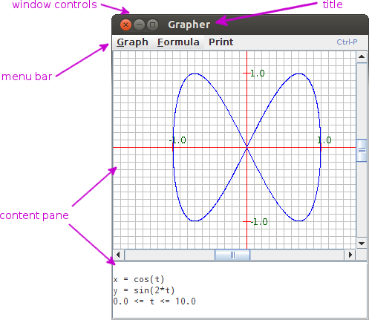
Frames
In Java, a frame is an ‘outside’ window that has nice borders, various buttons along the top border, and other built-in things.
A frame is a container object where GUI components can be placed in it.
GUI-based application programs are usually organized around one or more frames.
Elements of a Frame

Slide 11
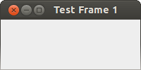
Small GUI Example - TestFrame1.java
import javax.swing.*;
public class TestFrame1 {
public static void main(String[] args) {
JFrame myframe = new JFrame();
myframe.setSize(200,100);
myframe.setVisible( true );
}
}
The Swing package is imported since that is where JFrame is defined. Notice the ‘x’ in javax.swing.*.
A JFrame object is constructed.
The object’s setSize() method sets its width and height in pixels.
The object’s setVisible() method makes it visible on the screen, but it does not destroy the software object

Slide 12
Closing a Frame (Main Window)
By default, when the user closes a frame with the close button, the frame is hidden.
The frame is then invisible, the frame still exists and the program is not terminated.
If you want to close the window, you can either execute the dispose() method or set the default close behaviour using the setDefaultCloseOperation() method
public static void main(String[] args) {
…
myframe.dispose();
…
myframe.setDefaultCloseOperation(JFrame.EXIT_ON_CLOSE);
}
Notes:
System.exit(int) causes program to finish and pass 0 which says no error to the OS!

Slide 13
setDefaultCloseOperation(...) options
DO NOTHING ON CLOSE
Don’t do anything when the user requests that the window close.
Instead, the program should probably use a window listener that performs some other action in its windowClosing() method.
HIDE ON CLOSE (the default for JDialog and JFrame)
Hide the window when the user closes it.
DISPOSE ON CLOSE (the default for JInternalFrame)
Hide and dispose of the window when the user closes it.
EXIT ON CLOSE (defined in the JFrame class)
Exit the application, using System.exit(0).

Slide 14
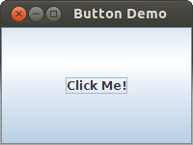
ButtonDemo1.java:
import javax.swing.*;
public class ButtonDemo1 {
public static void main(String[] args) {
JFrame myframe = new JFrame();
myframe.setSize(200,100);
myframe.setDefaultCloseOperation(JFrame.EXIT_ON_CLOSE);
JButton mybutton = new JButton("Click Me");
myframe.add(mybutton);
myframe.setVisible( true );
}
}
A JButton object is created and added to the frame’s content pane.
However, nothing happen when you click the button. Also the button fills the whole content pane.

Slide 15
Layout Managers
When you add() buttons (and other components) to a content pane, a layout manager automatically decides what size they will be and where they will go.
It is convenient, because you can add components without worrying about the details.
You say what components you want, and the layout manager lays them out in the picture.
However, the layout manager sometimes makes odd choices.
There are several kinds of layout managers; each one has a different style of positioning components.

Slide 16
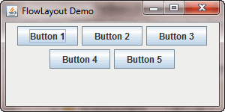
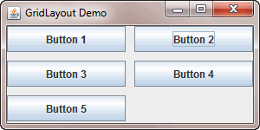
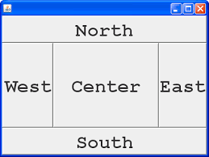
Layout Managers
FlowLayout
Components are set to a reasonable preferred size then positioned within container in the order they are added
starting from top left, working from left to right. When available width is used, next row is started
GridLayout
Number of rows and number of columns is specified.
Components are set to a reasonable preferred size then positioned down the first column, then down the second column, etc.
BorderLayout
Components are assigned to North, South, East, West and Center regions of the container.
They are sized to fill the whole of their region

Slide 17
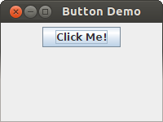
Setting the Layout Manager
The problem with the example is that the content pane of a JFrame has a BorderLayout by default
The button expands to fill the whole content pane due to BorderLayout policy.
To fix it, set the layout to FlowLayout.
public static void main(String[] args) {
JFrame myframe = new JFrame();
myframe.setSize(200,100);
myframe.setDefaultCloseOperation(JFrame.EXIT_ON_CLOSE);
myframe.setLayout(new FlowLayout());
…
}

Slide 18
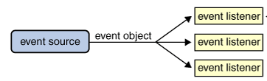
Events and Event Handling
When a GUI program is running, the user generates an event by interacting with a GUI component.
For a program to respond to an event there must be an event listener for it.
The event listener object contains listener methods for various types of events
If there is no listener for an event, the event is ignored.

Slide 19
Event Objects
Events in Java are encapsulated in objects
A WindowEvent object represents an event sent by a window (resize, close, ...);
An ActionEvent object represents an event sent by a button, text field, or menu;
An ItemEvent object represents an event from a checkbox, choicebox, or list (choice of an item);
A TextEvent represents an event from a text component
An AdjustmentEvent represents an event from a scrollbar
A KeyEvent represents an event from a key (press, release)
A MouseEvent or MouseMotionEvent represents events a mouse (click, press, release, drag, ...).

Slide 20
Event Listener Objects
When an event is sent by the GUI component, a method in the listener is to be invoked.
An event listener is an object in the program.
In particular, for each event the program must respond to, the program must
create an event listener object for the type of event.
register the listener object with the GUI component that generates the event (or with a component that contains it.)

Slide 21
Action Listener
Back to the job of handling the event of a click on the button.
We need an ActionListener object. This is a class which implements the java.awt.event.ActionListener interface.
Interface ActionListener declares the single method: actionPerformed(ActionEvent event)
The ActionEvent parameter represents an event (e.g. a button click). It contains information that can be used in responding to the event.
Since ActionListener is an interface, you use it with a class that will implement the actionPerformed() method.
It is common to implement the interface in the same class that contains the button(s).

Slide 22
Button Example with Action Listener (1 of 2)
//ButtonDemo2.java
import java.awt.*;
import java.awt.event.*; //need this for ActionListener
import javax.swing.*;
public class ButtonDemo2 extends JFrame implements ActionListener {
private JButton bChange;
public ButtonDemo2() { // constructor super("Button Demo");
makeFrame();
}

Slide 23
Button Example with Action Listener (2 of 2)
private void makeFrame() {
setLayout(new FlowLayout()); // set the flow layout
bChange = new JButton("Click Me!"); // construct a Button
add( bChange );
bChange.addActionListener(this);
setDefaultCloseOperation(JFrame.EXIT_ON_CLOSE);
setSize(200, 150);
setVisible(true);
}
// Method to handle the button click (’implments’)
public void actionPerformed(ActionEvent evt) { getContentPane().setBackground(Color.blue);
}
}

Slide 24
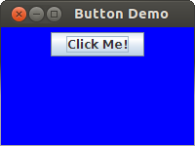
Result with ActionEvent Handling
Before:
After:

Slide 25
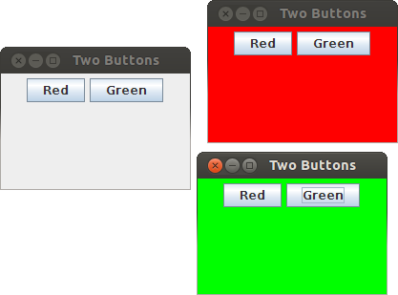
Some Hands-on Exercises
Develop a new program:
A frame will hold two buttons, one labelled ”Red”, the other ”Green”.
Use a FlowLayout layout manager so the buttons will be nicely positioned in the frame.
When the button marked ”Red” is clicked, the background will turn red.
When the button marked ”Green” is clicked, the background will turn green.
There will be an event listener that listens to the clicks from both buttons.
When the ”close button” of the frame is clicked, the application will quit.
Notes:
How many frames are there? Just one frame, contining the ”Red” button and the ”Green” button.
What GUI components will it/they contain?
What objects generate events? Both buttons send ActionEvents.
What objects receive events? The frame sends a WindowEvent (handled by default close operation).
How to determine the source of event? Use getSource() method

Slide 26
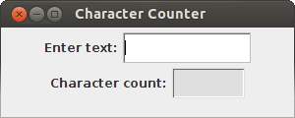
Jlabel and JTextField
A JLabel object simply displays text
A JTextField is a box that contains text.
User can type text into the box and the program can get it and then use it as data.
The program can output text to a JTextField and use for input: when ENTER is typed, it issues an ActionEvent.

Slide 27
public class CharCounter extends JFrame implements ActionListener {
private JLabel inLabel = new JLabel("Enter text:");
private JTextField inText = new JTextField(15);
private JLabel outLabel = new JLabel("Character count:");
private JTextField outText = new JTextField(8);
public CharCounter() { //constructor
super("Character Counter");
setLayout(new FlowLayout());
add(inLabel); add(inText);
add(outLabel); add(outText) ;
inText.addActionListener(this);
outText.setEditable(false);
setDefaultCloseOperation( JFrame.EXIT_ON_CLOSE);
setSize(300, 120);
setVisible(true);
}
public void actionPerformed(ActionEvent evt) {
String stg = inText.getText();
outText.setText(""+stg.length());
}
}

Slide 28
setEditable() method
Use this method to prevent the user from entering text into the text field:
The setEditable() method has one boolean parameter: true ⇒ field can be edited by user false ⇒ field cannot be edited by user
In summary, common JTextField methods are
String getText()
void setText(String s)
setEditable(boolean b)
boolean isEditable()
void setBackground(Color c)
void addActionLister(ActionListener l)

Slide 29
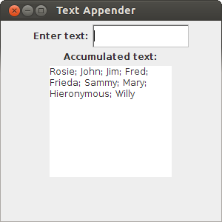
JTextArea
Similar to text field, but allows multiple lines
It does not generate ActionEvent on ENTER, so not suitable for input
Constructors: JTextArea(), JTextArea(String text), JTextArea(int rows, int columns), JTextArea(String text, int rows, int columns)
Common methods: String getText(), void setText(String s), append(String s), setEditable(boolean b), boolean isEditable(), void setBackground(Color c), etc
Default behavior is to expand width-wise as text fills the area.
setLineWrap(true) to make it wrap text to the following line.
setWrapStyleWord(true) to make it wrapping on whole words.
Notes:
You can also give the text area scroll-bars by adding it to the container inside a JScrollPane

Slide 30
public class TextAppender extends JFrame implements ActionListener {
private JLabel inLabel = new JLabel("Enter text:");
private JTextField inText = new JTextField(15);
private JLabel outLabel = new JLabel("Accumulated text:");
private JTextArea outText = new JTextArea(10, 15);
public TextAppender() { //constructor
super("Text Appender"); setLayout(new FlowLayout());
add(inLabel); add(inText); add(outLabel); add(outText);
inText.addActionListener(this);
outText.setEditable(false);
outText.setLineWrap(true);
outText.setWrapStyleWord(true);
setDefaultCloseOperation(JFrame.EXIT_ON_CLOSE);
setSize(300, 300); setVisible(true);
}
public void actionPerformed(ActionEvent evt) {
String stg = inText.getText(); inText.setText("");
if (outText.getText().length() == 0)
outText.setText(stg);
else
outText.append("; "+stg);
}
}

Slide 31
Panels, JPanel and Layout
A panel is a container for components that does not create a window of its own.
It is a ‘logical’ rectangle on the screen, both a component and a container, to help organise layout
You can add components to a panel, nested them (add components, panels to ‘bigger’ panels or frame)
Each panel has its own layout manager that lays out the components inside the panel.
The content pane’s layout manager arranges the panels as if each one were a single component.
JPanel is the swing version of a panel and the default layout manager of JPanel is flow.

Slide 32
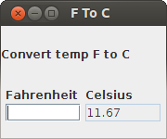
A JPanel Example
Design and implement a GUI application that converts a temperature expressed in Fahrenheit into Celsius.
C = (F − 32) ∗ 5/9
Try to adopt MVC architecture in the design.
Use JPanel for a more robust layout:
The panel p1 uses a grid layout to hold the input box underneath its label;
The panel p2 uses a grid layout to hold the output box underneath its label;
These two panel components are added to panel p3, side by side, since default layout is flow;
The title and p3 are added to the main frame using grid layout.

Slide 33
public class FtoCGUI extends JFrame implements ActionListener {
private JLabel title = new JLabel("Convert temp F to C");
private JLabel inLabel = new JLabel("Fahrenheit");
private JLabel outLabel = new JLabel("Celsius");
private JTextField inFahr = new JTextField(7);
private JTextField outCel = new JTextField(7);
public FtoCGUI() { //constructor
super("F To C");
JPanel p1 = new JPanel(); p1.setLayout(new GridLayout(2,1));
JPanel p2 = new JPanel(); p2.setLayout(new GridLayout(2,1));
p1.add(inLabel); p1.add(inFahr); p2.add(outLabel); p2.add(outCel);
JPanel p3 = new JPanel(); p3.add(p1); p3.add(p2);
setLayout(new GridLayout(2,1)); add(title); add(p3);
inFahr.addActionListener(this);
outCel.setEditable(false);
setDefaultCloseOperation(JFrame.EXIT_ON_CLOSE);
setSize(180, 150); setVisible(true);
}
public void actionPerformed( ActionEvent evt) {
String userInput = inFahr.getText() ;
double ft = Double.parseDouble(userInput);
FTemp temp = new FTemp(ft);
outCel.setText(String.format("%5.2f", temp.convFToC()));
}

Slide 34
JRadioButton
Radio buttons generate action events just as do push buttons.
Use setActionCommand(String) and getActionCommand() to recognise a particular JRadioButton.
Normally radio buttons are placed in groups:
in a JPanel, to control how they are displayed, and also in a javax.swing.ButtonGroup, to control which buttons may be active simultaneously.
Clicking a radio button deselects all other buttons in the group
A button group is an object which must be constructed before Radio buttons are added to it.
Use isSelected() method to tell whether a radio button is selected.

Slide 35
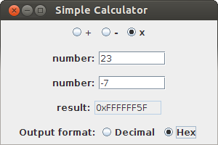
A JRadioButton Example
A simple calculator adds, subtract, multiplies integers;
Input is via two JTextFields; output is to a non-editable JTextField.
You choose operation using three JRadioButtons in a ButtonGroup.
Displays answer in decimal or hex: choose using two JRadioButtons in a ButtonGroup.
The calculator example uses BorderLayout:
EAST, WEST not used; they shrink to a ‘small’ (zero!) size.
The operation choice radio button panel is NORTH.
The output format choice radio button panel is SOUTH.
The three text boxes panels are in an outer JPanel in the CENTER

Slide 36
Mouse Event Handling
Two event listener interfaces for dealing with mouse events
java.awt.event.MouseListener listens for MouseEvents generated when the mouse has a button pressed, released, or clicked, or when it enters or exits the bounds of the component.
java.awt.event.MouseMotionListener listens for MouseEvents generated when the mouse is dragged or moved across the component. (Dragged = moved with a button down)
MouseListener and MouseMotionListener methods:
mouseEntered(MouseEvent evt); mouseExited(MouseEvent evt); mousePressed(MouseEvent evt); mouseReleased(MouseEvent evt); mouseClicked(MouseEvent evt)
mouseMoved(MouseEvent evt); mouseDragged(MouseEvent evt)
java.awt.event.MouseEvent has methods to report mouse coordinates and button state.

Slide 37
A Mouse Handling Example
A simple example: implements all mouse methods and report mouse position and button status on console:
import java.awt.*;
import java.awt.event.*;
import javax.swing.*;
public class MouseTracker extends JFrame
implements MouseListener, MouseMotionListener {
public MouseTracker () {
super("Demonstration of Mouse Events"); addMouseListener (this); addMouseMotionListener(this); setDefaultCloseOperation(EXIT_ON_CLOSE); setSize(400, 300);
setVisible(true);
}
....

Slide 38
Example - continued
//helper
public void sMsg(String legend, MouseEvent evt) { System.out.printf("%s at [%d, %d]; button state = %d\n",
legend, evt.getX(), evt.getY(), evt.getButton());
}
//MouseListener methods ...
public void mouseClicked(MouseEvent e) {sMsg("Clicked", e);} public void mousePressed(MouseEvent e) {sMsg("Pressed", e);} public void mouseReleased(MouseEvent e) {sMsg("Released",e);} public void mouseEntered(MouseEvent e) {sMsg("Entered", e);} public void mouseExited (MouseEvent e) {sMsg("Exited", e);}
//MouseMotionListener methods
public void mouseDragged (MouseEvent e) {sMsg("Dragged", e);} public void mouseMoved (MouseEvent e) {sMsg("Moved", e);}
}

Slide 39
Another Example
A simple reaction-timing game, ClickMe.java
The game window is a single JPanel, in CENTER, plus a status display, SOUTH
A string “Click me” is displayed in a random position on the game window and the time elapsed until a mouse click lands near it is displayed in the status display.
A JPanel can be ‘painted on’ using the low-level graphics methods of the java.awt.Graphics object associated with the JPanel.
Provide a method PaintComponent(Graphics g) in the game class, which extends the JPanel.
It starts with super.paintComponent(g) to paint the underlying JPanel, then does game-specific painting.
Do not usually call super.paintComponent() directly; rather, call JPanel’s repaint() method to ‘queue’ a repaint of the window.

Slide 40
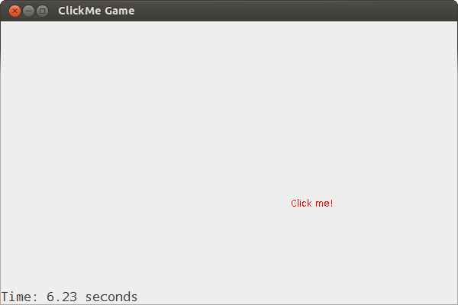
ClickMe.java

Slide 41
PaintComponent(Graphics)
public void paintComponent(Graphics g) { super.paintComponent(g);
if (newPos) {
g.setColor(getBackground());
g.drawString("Click me!", x, y);
x = rng.nextInt(getWidth()-60);
y = 20+rng.nextInt(getHeight()-25);
Time = System.currentTimeMillis();
newPos = false;
}
if (x >=0 && y >=0) {
g.setColor(Color.red);
g.drawString("Click me!", x, y);
}
}

Slide 42
Dialogues
Displayed to give information or solicit input
Modal dialogues block all other interaction until dismissed
Non-modal dialogues allow other interaction;
may be undesirable
javax.swing.JOptionPane provides some ‘standard’ dialogues
Message dialogue: message text plus an OK button.
Confirm dialogue has yes/no/cancel options
Input dialogue has a prompt and an input field; OK/cancel buttons

Slide 43
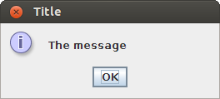
Message Dialogue
.....
JOptionPane.showMessageDialog(frame, "The message", "Title", JOptionPane.INFORMATION_MESSAGE);
.....
The last parameter chooses the information icon.

Slide 44
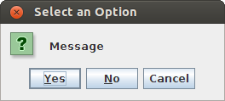
Confirm Dialogue
.....
int cnf = JOptionPane.showConfirmDialog(frame, "Question?"); System.out.printf("The result was %d\n", cnf);
.....
YES → 0, NO → 1, CANCEL → 2

Slide 45
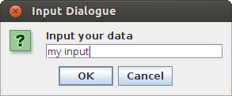
Input Dialogue
.....
String inp = JOptionPane.showInputDialog(frame, "Input your data", "Input Dialogue", JOptionPane.QUESTION_MESSAGE);
System.out.printf("The input was ’%s’\n", inp);
.....
The last parameter chooses the question icon.
The return value on OK is the input string; CANCEL → null

Slide 46
Seminar
Read relevant documents available in related session section on Blackboard.
Practice the sample programs using NetBeans

Slide 47
What we covered
Java GUI
AWT & Swing Classes
Dialogues
Event-driven Programming
Action Listeners
Layout Managers

Slide 48

References
Brian Cole, Robert Eckstein, James Elliott, Marc Loy, Dave Wood. (2002) Java Swing, 2nd Edition
Herbert Schildt (2021) Java: The Complete Reference, 12th Edition

